Slide 1
MACHINE LEARNING :

Slide 2
NAÏVE BAYES

Slide 3
Naïve Bayes Classifier Algorithm
Naïve Bayes algorithm is a supervised learning algorithm, which is based on Bayes theorem and used for solving classification problems
The Naïve Bayes Classifier is a simple and effective classification method that aids in the development of fast machine learning models capable of making quick predictions
The fundamental Naïve Bayes assumption is that each feature makes an independent and equal contribution to the outcome. One particular feature in a class doesn’t affect the presence of another one
It is a probabilistic classifier, which means it predicts on the basis of the probability of an object

Slide 4
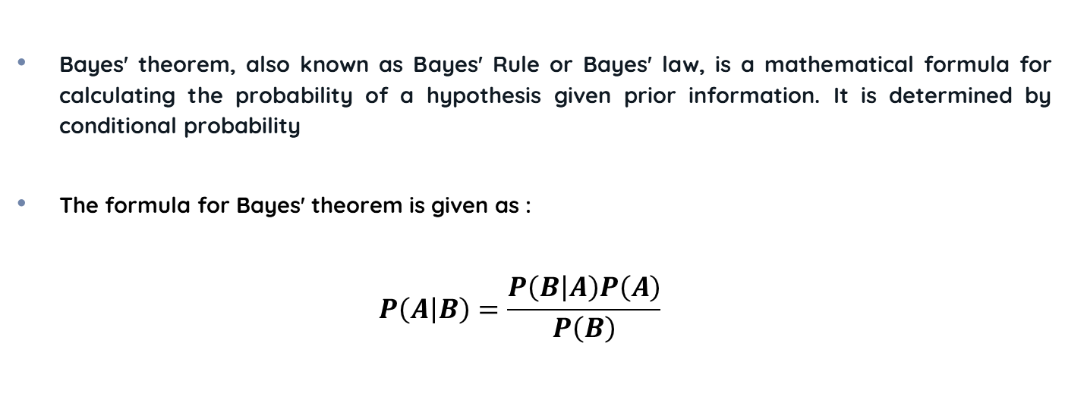
Bayes Theorem
Bayes' theorem, also known as Bayes' Rule or Bayes' law, is a mathematical formula for calculating the probability of a hypothesis given prior information. It is determined by conditional probability
The formula for Bayes' theorem is given as :
$$P\left(\left.A\right|B\right)=\frac{P\left(\left.B\right|A\right)P\left(A\right)}{P\left(B\right)}$$

Slide 5
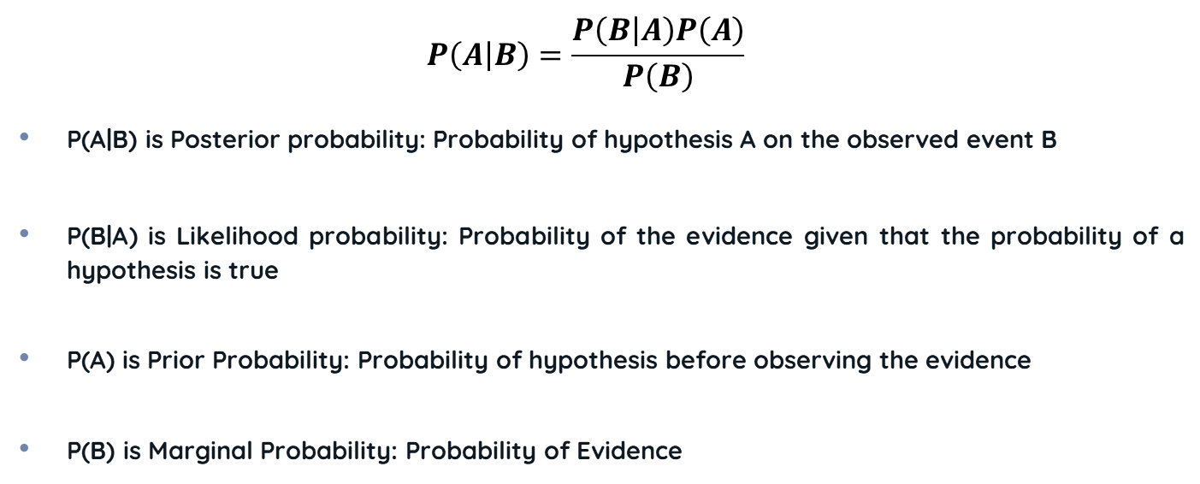
Bayes Theorem
$$P\left(\left.A\right|B\right)=\frac{P\left(\left.B\right|A\right)P\left(A\right)}{P\left(B\right)}$$
P(A|B) is Posterior probability: Probability of hypothesis A on the observed event B
P(B|A) is Likelihood probability: Probability of the evidence given that the probability of a hypothesis is true
P(A) is Prior Probability: Probability of hypothesis before observing the evidence
P(B) is Marginal Probability: Probability of Evidence

Slide 6
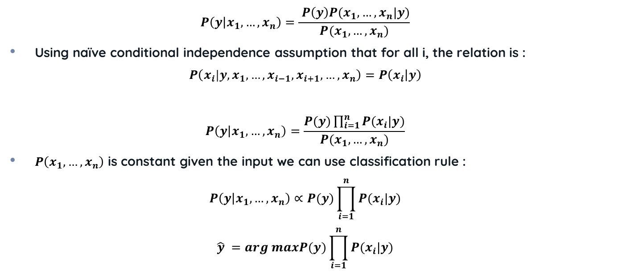
Mathematical Concept
$$P\left(\left.y\right|x_{1},…,x_{n}\right)=\frac{ P\left(y\right)P(x_{1},…,x_{n}|y)}{P(x_{1},…,x_{n})}$$
Using naïve conditional independence assumption that for all i, the relation is :
$$P\left(x_{i}|y, x_{1},…,x_{i−1},x_{i+1},…,x_{n}\right)=P\left(x_{i} | y\right)$$
$$P\left(\left.y\right|x_{1},…,x_{n}\right)=\frac{P(y)\prod_{i=1}^{n}{P(x_{i}|y)}}{P(x_{1},…,x_{n})}$$
$P\left(x_{1},…,x_{n}\right)$ is constant given the input we can use classification rule :
$$P\left(\left.y\right|x_{1},…,x_{n}\right)∝P(y)\prod_{i=1}^{n}{P(x_{i}|y)}$$
$$\hat{y} =arg maxP(y)\prod_{i=1}^{n}{P(x_{i}|y)}$$

Slide 7
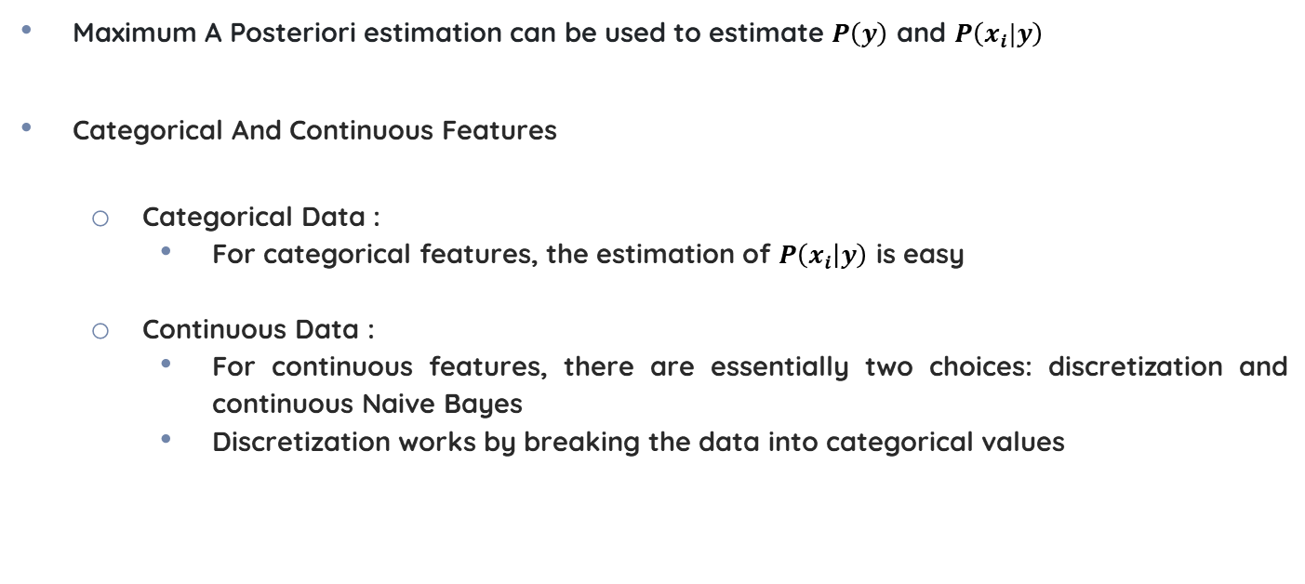
Mathematical Concept
Maximum A Posteriori estimation can be used to estimate $P\left(y\right)$ and $P\left(x_{i}|y\right)$
Categorical And Continuous Features
Categorical Data :
For categorical features, the estimation of $P\left(x_{i} | y\right)$ is easy
Continuous Data :
For continuous features, there are essentially two choices: discretization and continuous Naive Bayes
Discretization works by breaking the data into categorical values

Slide 8
RESEARCH PAPER REVIEW
Fake News Detection Using Naïve Bayes Classifier

Slide 9
Problem Statement
Electronic spamming is the practice of sending unsolicited messages (spam), with the help of electronic messaging system. Our aim to identify whether the message is legitimate or not
Spam messages and fake news articles have a lot of common properties:
They often have a lot of grammatical mistakes
They are often emotionally colored
They often try to affect reader’s opinion on some topics in manipulative way
Their content is often not true
Fake news articles and spam messages indeed share a lot of important properties. Therefore, we use similar approaches for spam filtering and fake news detection
Naive Bayes is a simple technique for constructing classifiers and is a popular statistical technique for Fake news detection

Slide 10
Problem Statement
To detect fake news Naïve Bayes uses bag of words feature
Naive Bayes classifiers work by correlating the use of tokens with legitimate and fake news and then using Bayes theorem to calculate a probability that an email is or is not a spam message
The dataset contains information about Facebook posts. They were collected from three large Facebook pages each from the right and from the left, as well as three large mainstream political news pages (Politico, CNN, ABC News)
Raters were asked to provide notes and sources to explain their rulings of “mixture of true and false” or “mostly false.”

Slide 11
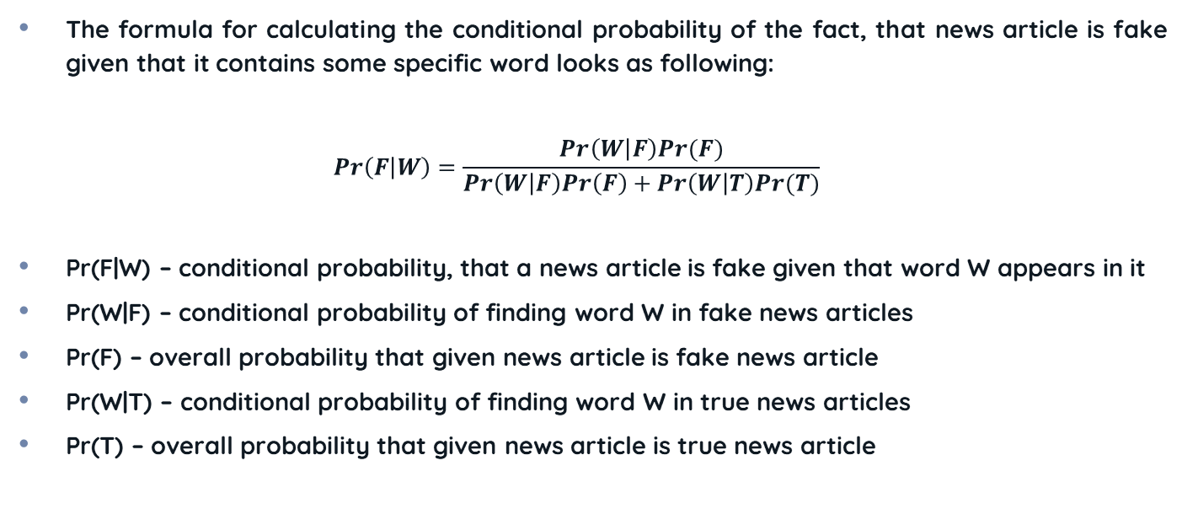
ML Model Implementation
The formula for calculating the conditional probability of the fact, that news article is fake given that it contains some specific word looks as following:
$$Pr\left(F | W\right)=\frac{Pr\left(W | F\right)Pr(F)}{Pr\left(W | F\right)Pr\left(F\right)+Pr\left(W | T\right)Pr(T)}$$
Pr(F|W) – conditional probability, that a news article is fake given that word W appears in it
Pr(W|F) – conditional probability of finding word W in fake news articles
Pr(F) – overall probability that given news article is fake news article
Pr(W|T) – conditional probability of finding word W in true news articles
Pr(T) – overall probability that given news article is true news article

Slide 12
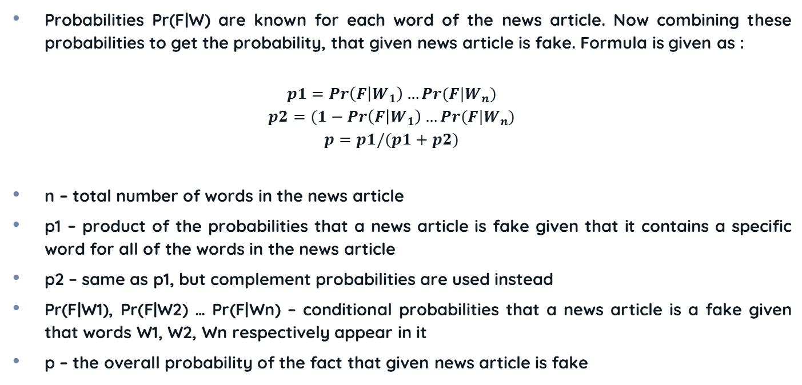
ML Model Implementation
Probabilities Pr(F|W) are known for each word of the news article. Now combining these probabilities to get the probability, that given news article is fake. Formula is given as :
$$p1=Pr\left(F | W_{1}\right)…Pr(F|W_{n})$$
$$p2=(1−Pr\left(F | W_{1}\right)…Pr(F|W_{n})$$
$$p=p1/(p1+p2)$$
n – total number of words in the news article
p1 – product of the probabilities that a news article is fake given that it contains a specific word for all of the words in the news article
p2 – same as p1, but complement probabilities are used instead
Pr(F|W1), Pr(F|W2) … Pr(F|Wn) – conditional probabilities that a news article is a fake given that words W1, W2, Wn respectively appear in it
p – the overall probability of the fact that given news article is fake

Slide 13

ML Model Implementation
Training set contains lots of news articles, labeled as true or fake one can define the probability of finding specific word in fake news article as a ratio of the fake news articles
The data is divided into three subsets: training dataset, validation dataset, test dataset. Test dataset was used to get the unbiased estimation of how well the classifier performs on new data
$p=p1/(p1+p2)$ This formula is often used for fake news detection
LOADING DATASET
PREPROCESSING
SPLITTING DATA
NAÏVE BAYES
TESTING

Slide 14
Hyperparameter Tuning
The best results on the validation dataset were received with the unconditional probability of the fact, that any news article is correct being equal to 0.59 and the true probability threshold being equal to 0.8
The ‘unconditional probability of any news article being correct’ and ‘the true probability threshold’ are the global parameters that were tuned
The true probability threshold is a value such that every article with a ‘probability of being true news article’ greater than the threshold is classified as a ‘true news article’ by the classifier, while all other articles are classified as ‘false news articles’
If the classifier does not recognize all of the words in a news article, it will report that it is unable to classify the article

Slide 15
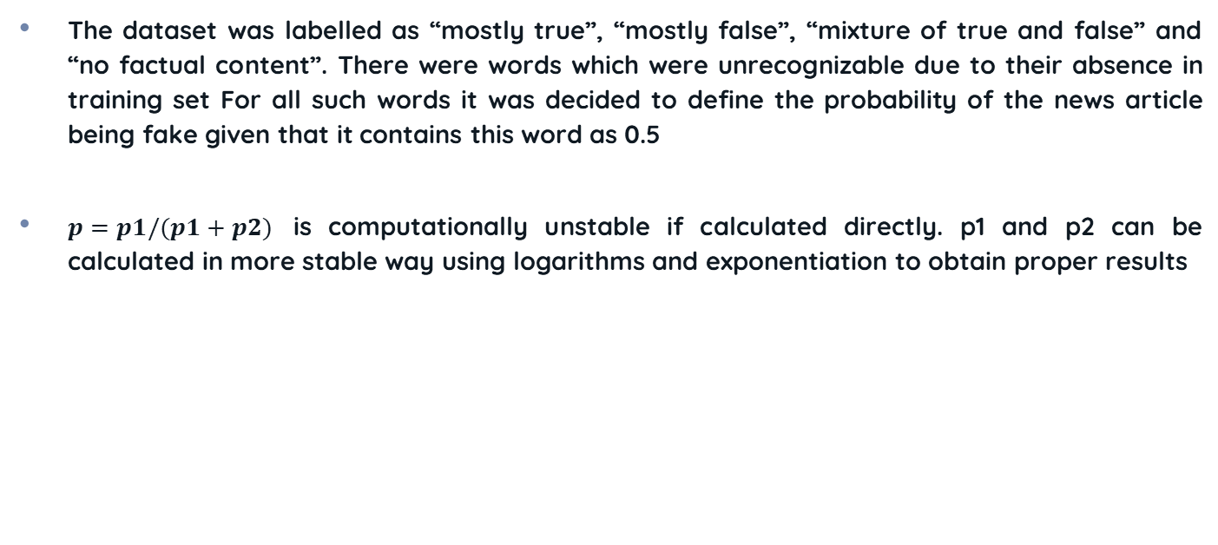
Hyperparameter Tuning
The dataset was labelled as “mostly true”, “mostly false”, “mixture of true and false” and “no factual content”. There were words which were unrecognizable due to their absence in training set For all such words it was decided to define the probability of the news article being fake given that it contains this word as 0.5
$p=p1/(p1+p2)$ is computationally unstable if calculated directly. p1 and p2 can be calculated in more stable way using logarithms and exponentiation to obtain proper results

Slide 16
Result and Conclusion
Out of 927 news in the dataset only 46 were fake news i.e. 4.9% of the total which led to a slightly bit off target classification of fake news
Out of 927 articles the classifier was unable to classify 228 articles as neither True or Fake
News Article Type | Total No. of News | Correctly Classified News | Classification Accuracy
True | 881 | 666 | 75.59%
Fake | 46 | 33 | 71.73%
Total | 927 | 699 | 75.40%

Slide 17
Result and Conclusion
When the classifier classifies the news article as fake the result is considered positive
Number of false positive examples is the number of news articles incorrectly classified as fake
Number of true negative examples is the number of news articles, correctly classified as true
Number of false negative examples is the number of news articles incorrectly classified as true
Precision = tp / (tp + fp); tp – number of true positive examples; fp – number of false positive examples
The precision comes out to be 0.71

Slide 18
Result and Conclusion
The performance of the classifier can be improved :
Increasing the Dataset
Increasing the length of the news articles
Removing stop words
Stemming
Considering rare words separately
The result suggests that the classification was a success and can be improves by taking few fields into consideration

Slide 19
REFERENCE
Mykhailo Granik, Volodymyr Mesyura, ‘Fake News Detection Using Naïve Bayes Classifier’. 2017 IEEE First Ukraine Conference on Electrical and Computer Engineering (UKRCON), 2017.

Slide 20
THANK
YOU

